Slide 1
Business Architecture and requirements alignment
Progress Update, White Paper, and BIZBOK Plans
Presented by:
Alex Randell
Business Architect, Principal Financial Group
Collaboration Team Lead, Business Architecture & Requirements Alignment
Eric Spellman
Practice Director, Magic Hat Consultant

Slide 2
Group Charter
Purpose: “Highlight how to use business architecture to improve, frame and organize business requirements”
Goals:
Formulate structure for aligning requirements to business architecture
Document position via white paper
Update BIZBOK section 6.3
Timeline:
White Paper – March 2014
BIZBOK Updates – July & December 2014

Slide 3
Progress To Date
Meeting every two weeks as a larger group
White paper group working daily
Multiple options for what to align, at multiple levels
Primary alignment is capabilities to requirements
Not building specific connections to levels of requirements at this point
Webinar
March 12
Overview of position
Highlighted importance of using business architecture as a framework
Available to members at:
http://www.businessarchitectureguild.org/Webinars

Slide 4
White Paper
Cross Industry Challenges
Product development: 4 of 5 new products will fail
Business Analysis and Requirements Management
70% of failed projects identify business requirements as primary root cause
$45 billion associated with rework

Slide 5
White Paper
Why?
Inability of organizations to link the relevancy of their products to what their customers are trying to get done in their lives
Business requirements tend to lose focus on the customer
Requirements lack a holistic frame of reference that enables requirements analysts to drive and trace requirements from customer need, through strategy, and down to the solutions being implemented

Slide 6

Shift in thinking & planning
Reactive
Proactive and Predictive
Requirements as a means
towards an end
Requirements are a core asset
(treated as IP)
Shift in Strategic Thinking
4 out of 5 Products Fail
70% Software Projects Fail
Execution not aligned with Strategy
Requirements are fragmented
Ineffective use of Resources
80% + Products are Successful
Organization leads the marketplace
ZERO Projects fail due to requirements
Organization is Agile & Responsive
Requirements are supported by a
foundation of Business Architecture
Shift in Organization Planning & Execution

Slide 7
White PAper
How Business Architecture can mitigate these risks:
Perspective
Align customer value with strategies, value streams, business capabilities, and planning roadmaps
Requirements Analysis Framework
Big Picture: provide a visual business context and structural components needed to perform thorough analysis
Traceability: ability to answer the question of why the requirement exists – traceable logic from business strategy through solution deployment
Reuse: requirements catalogued by capabilities within value stream stages

Slide 8
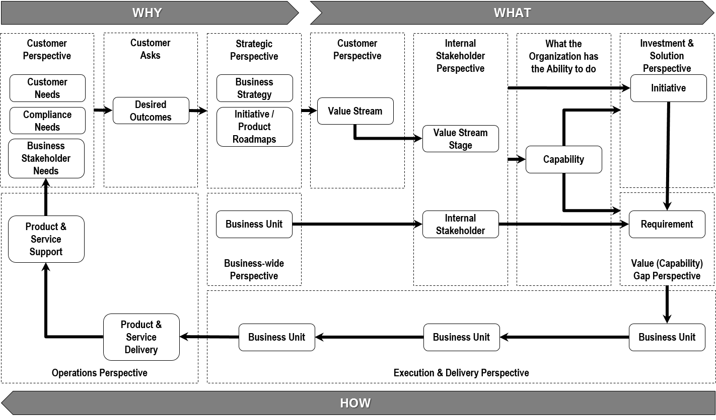
White PAper

Slide 9
Section 6.3 changes
Current State
Thorough overview
Covers why, benefits, and principles – so minimal changes here
Plans for Update
Strengthen core of ‘capabilities to requirements’
Increase use of examples
Add/strength Overview, Guidelines, and Usage Scenarios

Slide 10
Next Steps
Publish white paper – multiple venues – April/May 2014
Complete 1st round of section 6.3 changes for v4
Draft complete in April
Published in July
Consider follow-on white paper – Q3/Q4 of 2014
Publish 2nd round of section 6.3 changes – December 2014
Feedback / Questions?

